Slide 1
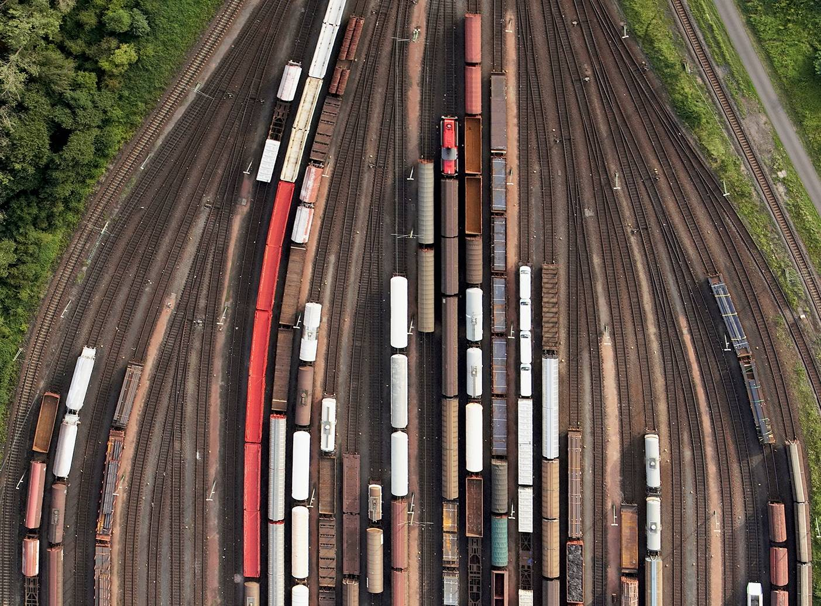



Chapter 4: String Matching
PRINCIPLES OF
DATA INTEGRATION
ANHAI DOAN ALON HALEVY ZACHARY IVES

Slide 2
Introduction
Find strings that refer to same real-world entities
  “David Smith” and “David R. Smith”
  “1210 W. Dayton St Madison WI” and “1210 West Dayton Madison WI 53706”
Play critical roles in many DI tasks
  Schema matching, data matching, information extraction
This chapter
  Defines the string matching problem
  Describes popular similarity measures
  Discusses how to apply such measures to match a large number of strings

Slide 3
Outline
Problem description
Similarity measures
  Sequence-based: edit distance, Needleman-Wunch, affine gap, Smith-Waterman, Jaro, Jaro-Winkler
  Set-based: overlap, Jaccard, TF/IDF
  Hybrid: generalized Jaccard, soft TF/IDF, Monge-Elkan
  Phonetic: Soundex
Scaling up string matching
  Inverted index, size filtering, prefix filtering, position filtering, bound filtering

Slide 4
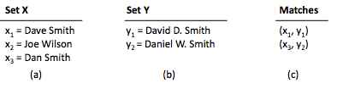
Problem Description
Given two sets of strings X and Y
  Find all pairs x 2 X and y 2 Y that refer to the same
  real-world entity
  We refer to (x,y) as a match
  Example
Two major challenges: accuracy & scalability

Slide 5
Accuracy Challenges
Matching strings often appear quite differently
  Typing and OCR errors: David Smith vs. Davod Smith
  Different formatting conventions: 10/8 vs. Oct 8
  Custom abbreviation, shortening, or omission:
  Daniel Walker Herbert Smith vs. Dan W. Smith
  Different names, nick names: William Smith vs. Bill Smith
  Shuffling parts of strings: Dept. of Computer Science, UW-Madison vs. Computer Science Dept., UW-Madison

Slide 6
Accuracy Challenges
Solution:
  Use a similarity measure s(x,y) 2 [0,1]
    The higher s(x,y), the more likely that x and y match
  Declare x and y matched if s(x,y) ≥ t
Distance measure/cost measure have also been used
  Same concept
  But smaller values ➔ higher similarities

Slide 7
Scalability Challenges
Applying s(x,y) to all pairs is impractical
  Quadratic in size of data
Solution: apply s(x,y) to only most promising pairs, using a method FindCands
  For each string x 2 X
  use method FindCands to find a candidate set Z µ Y
  for each string y 2 Z
  if s(x,y) ¸ t then return (x,y) as a matched pair
  We discuss ways to implement FindCands later

Slide 8
Outline
Problem description
Similarity measures
  Sequence-based: edit distance, Needleman-Wunch, affine gap, Smith-Waterman, Jaro, Jaro-Winkler
  Set-based: overlap, Jaccard, TF/IDF
  Hybrid: generalized Jaccard, soft TF/IDF, Monge-Elkan
  Phonetic: Soundex
Scaling up string matching
  Inverted index, size filtering, prefix filtering, position filtering, bound filtering

Slide 9
Edit Distance
Also known as Levenshtein distance
d(x,y) computes minimal cost of transforming x into y, using a sequence of operators, each with cost 1
  Delete a character
  Insert a character
  Substitute a character with another
Example: x = David Smiths, y = Davidd Simth,
d(x,y) = 4, using following sequence
    Inserting a character d (after David)
    Substituting m by i
    Substituting i by m
    Deleting the last character of x, which is s

Slide 10
Edit Distance
Models common editing mistakes
  Inserting an extra character, swapping two characters, etc.
  So smaller edit distance ➔ higher similarity
Can be converted into a similarity measure
  s(x,y) = 1 - d(x,y) / [max(length(x), length(y))]
  Example
    s(David Smiths, Davidd Simth) = 1 – 4 / max(12, 12) = 0.67

Slide 11
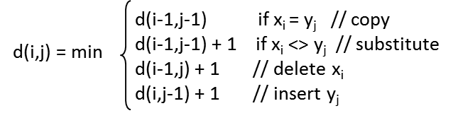
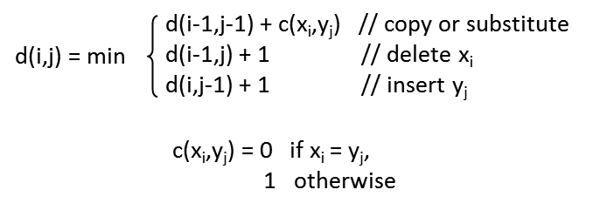
Computing Edit Distance using Dynamic Programming
Define x = x₁x₂☹ x_{n}, y = y₁y₂☹ y_{m}
  d(i,j) = edit distance between x₁x₂☹ x_{i} and y₁y₂☹ y_{j},
  the i-th and j-th prefixes of x and y
Recurrence equations

Slide 12
Example
x = dva, y = dave
y0 y1 y2 y3 y4
y0 y1 y2 y3 y4
 |  | d | a | v | e
 | 0 | 1 | 2 | 3 | 4
d | 1 | 0 | 1
v | 2
a | 3
 |  | d | a | v | e
 | 0 | 1 | 2 | 3 | 4
d | 1 | 0 | 1 | 2 | 3
v | 2 | 1 | 1 | 1 | 2
a | 3 | 2 | 1 | 2 | 2
x = d – v a
y = d a v e
x0
x0
x1
x1
substitute a with e
insert a (after d)
x2
x2
x3
x3
Cost of dynamic programming is O(|x||y|)

Slide 13
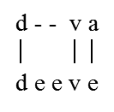
Needleman-Wunch Measure
Generalizes Levenshtein edit distance
Basic idea
  defines notion of alignment between x and y
  assigns score to alignment
  return the alignment with highest score
Alignment: set of correspondences between characters of x and y, allowing for gaps

Slide 14
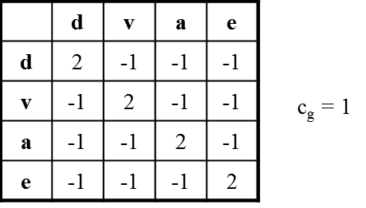
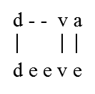
Scoring an Alignment
Use a score matrix and a gap penalty
Example
  alignment score = sum of scores of all correspondences -
  sum of penalties of all gaps
    e.g., for the above alignment, it is 2 (for d-d) + 2 (for v-v) -1 (for a-e) -2 (for gap) = 1
    this is the alignment with the highest score, it is returned as the Needleman-Wunch score for dva and deeve.

Slide 15
Needleman-Wunch Generalizes Levenshtein in Three Ways
Computes similarity scores instead of distance values
Generalizes edit costs into a score matrix
  allowing for more fine-grained score modeling
  e.g., score(o,0) > score(a,0)
  e.g., different amino-acid pairs may have different semantic distance
Generalizes insertion and deletion into gaps, and generalizes their costs from 1 to C_{g}

Slide 16
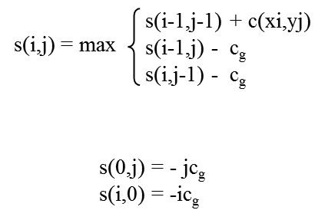
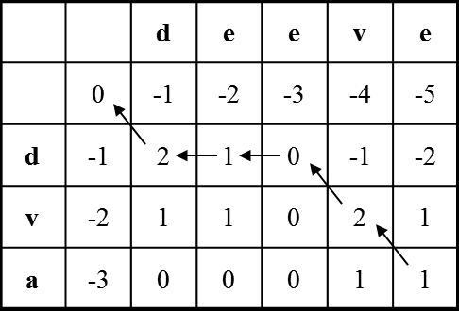

Computing Needleman-Wunch Score with Dynamic Programming

Slide 17
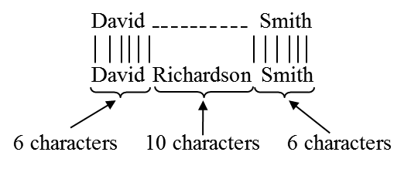
The Affine Gap Measure: Motivation
An extension of Needleman-Wunch that handles longer gap more gracefully
E.g., “David Smith” vs. “David R. Smith”
  Needleman-Wunch well suited here
  opens gap of length 2 right after “David”
E.g.,
  Needlement-Wunch not well suited here, gap cost is too high
  If each char corrspondence has score 2, c_{g} = 1, then the above has score 6*2 – 10 = 2

Slide 18
The Affine Gap Measure: Solution
In practice, gaps tend to be longer than 1 character
Assigning same penalty to each character unfairly punishes long gaps
Solution: define cost of opening a gap vs. cost of continuing the gap
  cost (gap of length k) = c₀ + (k-1)c_{r}
  c₀ = cost of opening gap
  c_{r} = cost of continuing gap, c₀ > c_{r}
E.g., “David Smith” vs. “David Richardson Smith”
  c₀ = 1, c_{r} = 0.5, alignment cost = 6*2 – 1 - 9*0.5 = 6.5

Slide 19
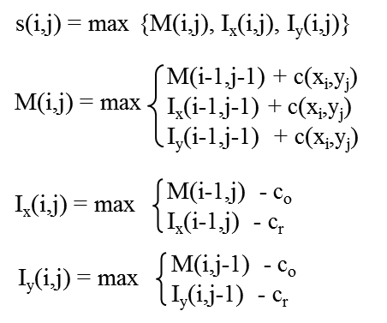
Computing Affine Gap Score using Dynamic Programming
The notes detail how these equations are derived

Slide 20
The Smith-Waterman Measure: Motivation
Previous measures consider global alignments
  attempt to match all characters of x with all characters of y
Not well suited for some cases
  e.g., “Prof. John R. Smith, Univ of Wisconsin” and “John R. Smith, Professor”
  similarity score here would be quite low
Better idea: find two substrings of x and y that are most similar
  e.g., find “John R. Smith” in the above case ➔ local alignment

Slide 21
The Smith-Waterman Measure:
Basic Ideas
Find the best local alignment between x and y, and return its score as the score between x and y
Makes two key changes to Needleman-Wunch
  allows the match to restart at any position in the strings (no longer limited to just the first position)
    if global match dips below 0, then ignore prefix and restart the match
  after computing matrix using recurrence equation, retracing the arrows from the largest value in matrix, rather than from lower-right corner
    this effectively ignores suffixes if the match they produce is not optimal
    retracing ends when we meet a cell with value 0 ➔ start of alignment

Slide 22
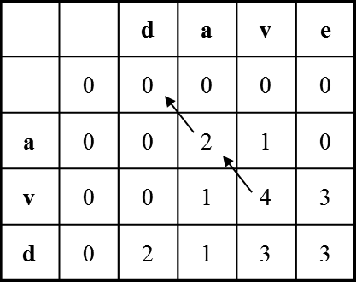
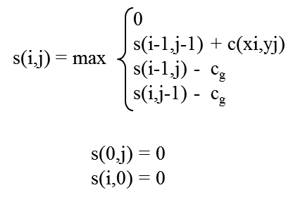
Computing Smith-Waterman Score using Dynamic Programming

Slide 23
The Jaro Measure
Mainly for comparing short strings, e.g., first/last names
To compute jaro(x,y)
  find common characters x_{i} and y_{j} such that
  x_{i} = y_{j} and |i-j| · min {|x|,|y|}/2
  intuitively, common characters are identical and positionally “close to each other”
  if the i-th common character of x does not match the i-th common character of y, then we have a transposition
  return jaro(x,y) = 1 / 3[c/|x| + c/|y| + (c – t/2)/c], where c is the number of common characters, and t is the number of transpositions

Slide 24
The Jaro Measure: Examples
x = jon, y = john
  c = 3 because the common characters are j, o, and n
  t = 0
  jaro(x,y) = 1 / 3(3/3 + 3/4 + 3/3) = 0.917
  contrast this to 0.75, the sim score of x and y using edit distance
x = jon, y = ojhn
  common char sequence in x is jon
  common char sequence in y is ojn
  t = 2
  jaro(x,y) = 0.81

Slide 25
The Jaro-Winkler Measure
Captures cases where x and y have a low Jaro score, but share a prefix ➔ still likely to match
Computed as
  jaro-winkler(x,y) = (1 – PL*PW)*jaro(x,y) + PL*PW
  PL = length of the longest common prefix
  PW is a weight given to the prefix

Slide 26
Outline
Problem description
Similarity measures
  Sequence-based: edit distance, Needleman-Wunch, affine gap, Smith-Waterman, Jaro, Jaro-Winkler
  Set-based: overlap, Jaccard, TF/IDF
  Hybrid: generalized Jaccard, soft TF/IDF, Monge-Elkan
  Phonetic: Soundex
Scaling up string matching
  Inverted index, size filtering, prefix filtering, position filtering, bound filtering

Slide 27
Set-based Similarity Measures
View strings as sets or multi-sets of tokens
Use set-related properties to compute similarity scores
Common methods to generate tokens
  consider words delimited by space
    possibly stem the words (depending on the application)
    remove common stop words (e.g., the, and, of)
    e.g., given “david smith” ➔ generate tokens “david” and “smith”
  consider q-grams, substrings of length q
    e.g., “david smith” ➔ the set of 3-grams are {##d, #da, dav, avi, …, h##}
    special character # is added to handle the start and end of string

Slide 28
The Overlap Measure
Let B_{x} = set of tokens generated for string x
Let B_{y} = set of tokens generated for string y
O(x,y) = |B_{x} Å B_{y}|
  returns the number of common tokens
E.g., x = dave, y = dav
  B_{x} = {#d, da, av, ve, e#}, B_{y} = {#d, da, av, v#}
  O(x,y) = 3

Slide 29
The Jaccard Measure
J(x,y) = |B_{x} Å B_{y}|/|B_{x} [ B_{y}|
E.g., x = dave, y = dav
  B_{x} = {#d, da, av, ve, e#}, B_{y} = {#d, da, av, v#}
  J(x,y) = 3/6
Very commonly used in practice

Slide 30
The TF/IDF Measure: Motivation
uses the TF/IDF notion commonly used in IR
  two strings are similar if they share distinguishing terms
  e.g., x = Apple Corporation, CA
  y = IBM Corporation, CA
  z = Apple Corp
  s(x,y) > s(x,z) using edit distance or Jaccard measure, so x is matched with y ➔ incorrect
  TF/IDF measure can recognize that Apple is a distinguishing term, whereas Corporation and CA are far more common ➔ correctly match x with z

Slide 31
Term Frequencies and
Inverse Document Frequencies
Assume x and y are taken from a collection of strings
Each string is coverted into a bag of terms called a document
Define term frequency tf(t,d) = number of times term t appears in document d
Define inverse document frequency idf(t) = N / N_{d}, number of documents in collection devided by number of documents that contain t
  note: in practice, idf(t) is often defined as log(N / N_{d}), here we will use the above simple formula to define idf(t)

Slide 32
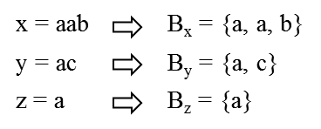
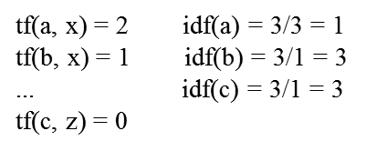
Example

Slide 33
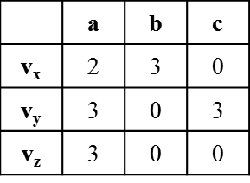
Feature Vectors
Each document d is converted into a feature vector v_{d}
v_{d} has a feature v_{d}(t) for each term t
  value of v_{d}(t) is a function of TF and IDF scores
  here we assume v_{d}(t) = tf(t,d) * idf(t)

Slide 34
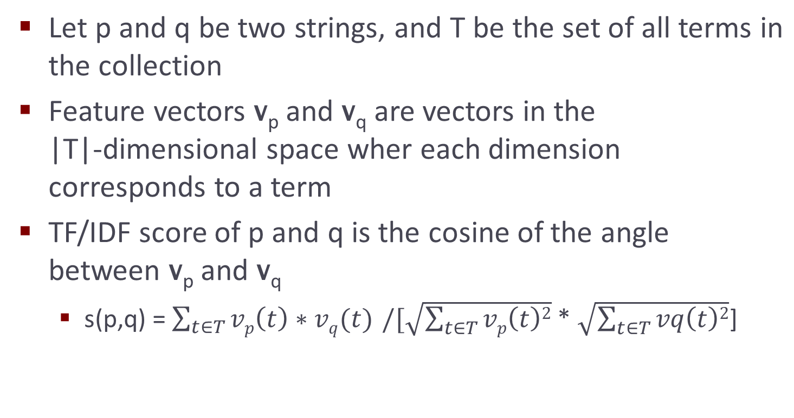
TF/IDF Similarity Score

Slide 35
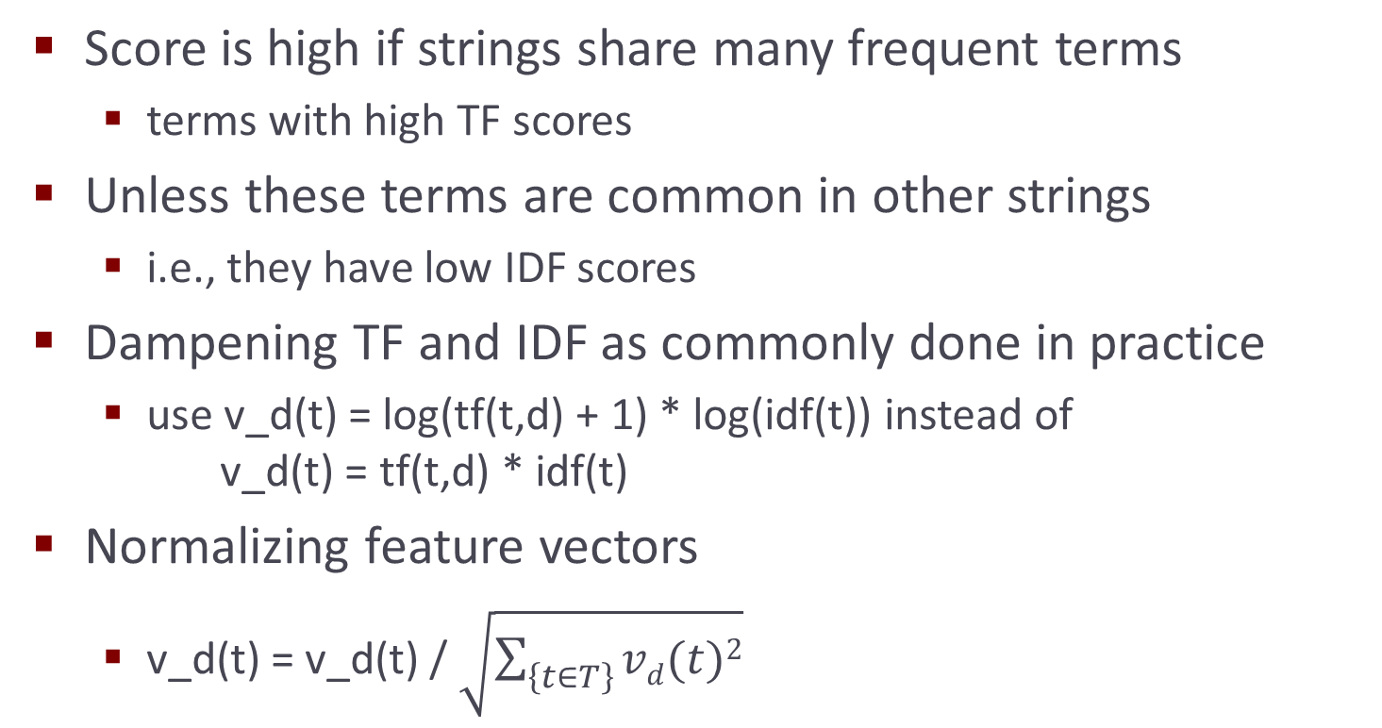
TF/IDF Similarity Score

Slide 36
Outline
Problem description
Similarity measures
  Sequence-based: edit distance, Needleman-Wunch, affine gap, Smith-Waterman, Jaro, Jaro-Winkler
  Set-based: overlap, Jaccard, TF/IDF
  Hybrid: generalized Jaccard, soft TF/IDF, Monge-Elkan
  Phonetic: Soundex
Scaling up string matching
  Inverted index, size filtering, prefix filtering, position filtering, bound filtering

Slide 37
Generalized Jaccard Measure
Jaccard measure
  considers overlapping tokens in both x and y
  a token from x and a token from y must be identical to be included in the set of overlapping tokens
  this can be too restrictive in certain cases
Example:
  matching taxonomic nodes that describe companies
  “Energy & Transportation” vs. “Transportation, Energy, & Gas”
  in theory Jaccard is well suited here, in practice Jaccard may not work well if tokens are commonly mispelled
    e.g., energy vs. eneryg
  generalized Jaccard measure can help such cases

Slide 38
Generalized Jaccard Measure
Let B_{x} = {x₁, …, x_{n}}, B_{y} = {y₁, …, y_{m}}
Step 1: find token pairs that will be in the “softened” overlap set
  apply a similarity measure s to compute sim score for each pair (x_{i}, y_{j})
  keep only those score ¸ a given threshold ®, this forms a bipartite graph G
  find the maximum-weight matching M in G
Step 2: return normalized weight of M as generalized Jaccard score
  GJ(x,y) = ∑ _{(xi,yj)2 M} s(x_{i},y_{j}) / (|B_{x}| + |B_{y}| - |M|)

Slide 39
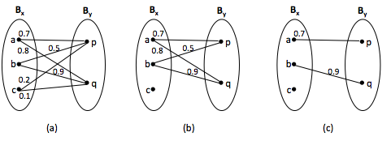
An Example
Generalized Jaccard score: (0.7 + 0.9)/(3 + 2 – 2) = 0.53

Slide 40
The Soft TF/IDF Measure
Similar to generalized Jaccard measure, except that it uses TF/IDF measure as the “higher-level” sim measure
  e.g., “Apple Corporation, CA”, “IBM Corporation, CA”, and “Aple Corp”, with Apple being mispelt in the last string
Step 1: compute close(x,y,k): set of all terms t2 B_{x} that have at least one close term u2 B_{y}, i.e., s’(t,u)¸ k
  s’ is a basic sim measure (e.g., Jaro-Winkler), k prespecified
Step 2: compute s(x,y) as in traditional TF/IDF score, but weighing each TF/IDF component using s’
  s(x,y) = ∑ _{t2 close(x,y,k)} v_{x}(t) * v_{y}(u*) * s’(t,u*)
  u*2 B_{y} maximizes s’(t,u) 8 u2 B_{y}

Slide 41
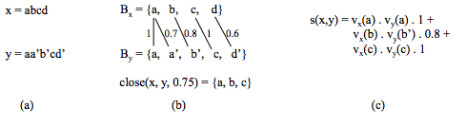
An Example

Slide 42
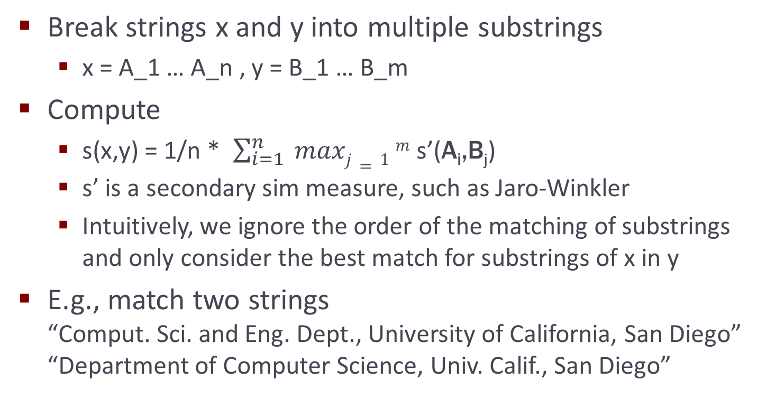
The Monge-Elkan Measure

Slide 43
Outline
Problem description
Similarity measures
  Sequence-based: edit distance, Needleman-Wunch, affine gap, Smith-Waterman, Jaro, Jaro-Winkler
  Set-based: overlap, Jaccard, TF/IDF
  Hybrid: generalized Jaccard, soft TF/IDF, Monge-Elkan
  Phonetic: Soundex
Scaling up string matching
  Inverted index, size filtering, prefix filtering, position filtering, bound filtering

Slide 44
Phonetic Similarity Measures
Match strings based on their sound, instead of appearances
Very effective in matching names, which often appear in different ways that sound the same
  e.g., Meyer, Meier, and Mire; Smith, Smithe, and Smythe
Soundex is most commonly used

Slide 45
The Soundex Measure
Used primarily to match surnames
  maps a surname x into a 4-letter code
  two surnames are judged similar if share the same code
Algorithm to map x into a code:
  Step 1: keep the first letter of x, subsequent steps are performed on the rest of x
  Step 2: remove all occurences of W and H. Replace the remaining letters with digits as follows:
    replace B, F, P, V with 1, C, G, J, K, Q, S, X, Z with 2, D, T with 3, L with 4, M, N with 5, R with 6
  Step 3: replace sequence of identical digits by the digit itself
  Step 4: Drop all non-digit letters, return the first four letters as the soundex code

Slide 46
The Soundex Measure
Example: x = Ashcraft
  after Step 2: A226a13, after Step 3: A26a13, Step 4 converts this into A2613, then returns A261
  Soundex code is padded with 0 if there is not enough digits
Example: Robert and Rupert map into R163
Soundex fails to map Gough and Goff, and Jawornicki and Yavornitzky
  designed primarily for Caucasian names, but found to work well for names of many different origins
  does not work well for names of East Asian origins
    which uses vowels to discriminate, Soundex ignores vowels

Slide 47
Outline
Problem description
Similarity measures
  Sequence-based: edit distance, Needleman-Wunch, affine gap, Smith-Waterman, Jaro, Jaro-Winkler
  Set-based: overlap, Jaccard, TF/IDF
  Hybrid: generalized Jaccard, soft TF/IDF, Monge-Elkan
  Phonetic: Soundex
Scaling up string matching
  Inverted index, size filtering, prefix filtering, position filtering, bound filtering

Slide 48
Scalability Challenges
Applying s(x,y) to all pairs is impractical
  Quadratic in size of data
Solution: apply s(x,y) to only most promising pairs, using a method FindCands
  For each string x 2 X
  use method FindCands to find a candidate set Z µ Y
  for each string y 2 Z
  if s(x,y) ¸ t then return (x,y) as a matched pair
  This is often called a blocking solution
  Set Z is often called the umbrella set of x
We now discuss ways to implement FindCands
  using Jaccard and overlap measures for now

Slide 49
Inverted Index over Strings
Converts each string y\in Y into a document, builds an inverted index over these documents
Given term t, use the index to quickly find documents of Y that contain t

Slide 50
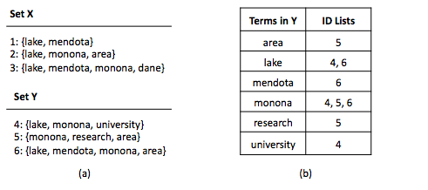
Example

Slide 51
Limitations
The inverted list of some terms (e.g., stop words) can be very long ➔ costly to build and manipulate such lists
Requires enumerating all pairs of strings that share at least one term. This set can still be very large in practice.

Slide 52
Size Filtering
Retrieves only strings in Y whose sizes make them match candidates
  given a string x\in X, infer a constraint on the size of strings in Y that can possibly match x
  uses a B-tree index to retrieve only strings that satisfy size constraints
E.g., for Jaccard measure J(x,y) = |x Å y| / |x [ y|
  assume two strings x and y match if J(x,y) ¸ t
  can show that given a string x2 X, only strings y such that
  |x|/t ¸ |y| ¸ |x|*t can possibly match x

Slide 53
Example
Consider x = {lake, mendota}. Suppose t = 0.8
If y2 Y matches x, we must have
  2/0.8 = 2.5 ¸ |y| ¸ 2* 0.8 = 1.6
  no string in Set Y satisfies this constraint ➔ no match

Slide 54
Prefix Filtering
Key idea: if two sets share many terms ➔ large subsets of them also share terms
Consider overlap measure O(x,y) = |x Å y|
  if |x Å y| ¸ k ➔ any subset x’ µ x of size at least |x| - (k – 1) must overlap y
To exploit this idea to find pairs (x,y) such that
O(x,y) ¸ k
  given x, construct subset x’ of size |x| - (k – 1)
  use an inverted index to find all y that overlap x’

Slide 55
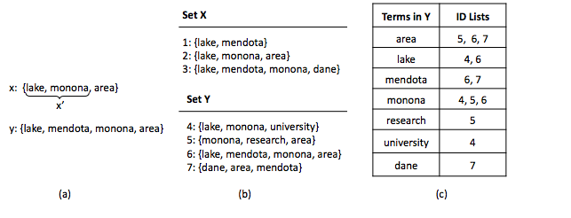
Example
Consider matching using O(x,y) ¸ 2
x₁ = {lake, mendota}, let x₁’ = {lake}
Use inverted index to find {y₄, y₆} which contain at least one token in x₁’

Slide 56
Selecting the Subset Intelligently
Recall that we select a subset x’ of x and check its overlap with the entire set y
We can do better by selecting a particular subset x’ and checking its overlap with only a particular subset y’ of y
How?
  impose an ordering O over the universe of all possible terms
    e.g., in increasing frequency
  reorder the terms in each x 2 X and y 2 Y according to O
  refer to subset x’ that contains the first n terms of x as the prefix of size n of x

Slide 57
Selecting the Subset Intelligently
How? (continued)
  can prove that if |x Å y| ¸ k, then x’ and y’ must overlap, where x’ is the prefix of size |x| - (k – 1) of x and y’ is the prefix of size |y| - (k – 1) of y (see notes)
Algorithm
  reorder terms in each x 2 X and y 2 Y in increasing order of their frequencies
  for each y 2 Y, create y’, the prefix of size |y| - (k – 1) of y
  build an inverted index over all prefixes y’
  for each x 2 X, create x’, the prefix of size |x| - (k – 1) of x, then use above index to find all y such that x’ overlaps with y’

Slide 58
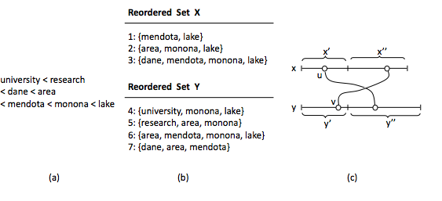
Example
x = {mendota, lake} ➔ x’ = {mendota}

Slide 59
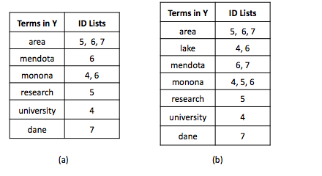
Example
See the notes for applying prefix filtering to Jaccard measure

Slide 60
Position Filtering
Further limits the set of candidate matches by deriving an upper bound on the size of overlap between x and y
e.g., x = {dane, area, mendota, monona, lake}
y = {research, dane, mendota, monona, lake}
Suppose we consider J(x,y) ¸ 0.8, in prefix filtering we consider x’ = {dane, area} and y’ = {research, dane} (see notes)
But we can do better than this. Specifically, we can prove that O(x,y) ¸ [t/(1+t)]*(|x| + |y|) = 4.44 (see notes)
  so can immediately discard the above (x,y) pair

Slide 61
Bound Filtering
Used to optimize the computation of generalized Jaccard similarity measure
Recall that
  GJ(x,y) = ∑ _{(xi,yj)2 M} s(x_{i},y_{j}) / (|B_{x}| + |B_{y}| - |M|)
Algorithm
  for each (x,y) compute an upper bound UB(x,y) and a lower bound LB(x,y) on GJ(x,y)
  if UB(x,y) · t ➔ (x,y) can be ignored, it is not a match
  if LB(x,y) ¸ t ➔ return (x,y) as a match
  otherwise compute GJ(x,y)

Slide 62
Computing UB(x,y) and LB(x,y)
For each x_{i} 2 B_{x}, find y_{j} 2 B_{y} with the highest element-level similarity, such that s(x_{i},y_{j}) ¸ ®. Call this set of pairs S₁.
For each y_{j} 2 B_{y}, find x_{i} 2 X with the highest element-level similarity, such that s(x_{i},y_{j}) ¸ ®. Call this set of pairs S₂.
Compute
  UB(x,y) = ∑ _{(xi,yj)2 S1[ S2} s(x_{i},y_{j}) / (|B_{x}| + |B_{y}| - |S₁ [ S₂|)
  LB(x,y) = ∑ _{(xi,yj)2 S1\ S2} s(x_{i},y_{j}) / (|B_{x}| + |B_{y}| - |S₁ \ S₂|)

Slide 63
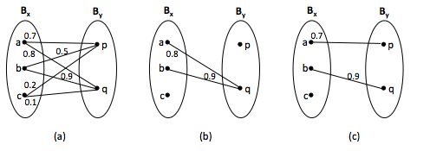
Example
S₁ = {(a,q), (b,q)}, S₂ = {(a,p), (b,q)}
UB(x,y) = (0.8+0.9+0.7+0.9)/(3+2-3) = 1.65
LB(x,y) = 0.9/(3+2-1) = 0.225

Slide 64
Extending Scaling Techniques to Other Similarity Measures
Discussed Jaccard and overlap so far
To extend a technique T to work for a new similarity measure s(x,y)
  try to translate s(x,y) into constraints on a similarity measure that already works well with T
The notes discuss examples that involve edit distance and TF/IDF

Slide 65
Summary
String matching is pervasive in data integration
Two key challenges:
  what similarity measure and how to scale up?
Similarity measures
  Sequence-based: edit distance, Needleman-Wunch, affine gap, Smith-Waterman, Jaro, Jaro-Winkler
  Set-based: overlap, Jaccard, TF/IDF
  Hybrid: generalized Jaccard, soft TF/IDF, Monge-Elkan
  Phonetic: Soundex
Scaling up string matching
  Inverted index, size/prefix/position/bound filtering

Slide 66
Acknowledgment
Slides in the scalability section are adapted from
http://pike.psu.edu/p2/wisc09-tech.ppt

